Slide 1
Question-2 about Future Smith
Dejan
09/29/18

Slide 2
Q1: Terms
1-1 Tribe owner who has created this tribe.
- Yes.
Is there another way to become a tribe owner except for creating tribe?
Yes, if they make someone else the tribe owner, i.e., pass the rights to someone else.
If so, in which screen can the tribe owner pass the rights to somebody else?
1-2 Project leader who has created this project. - Yes
Is there another way to become a project leader except for creating project? – Yes, if they make someone else the tribe owner, i.e., pass the rights to someone else.
If so, in which screen can the project leader pass the rights to somebody else?

Slide 3
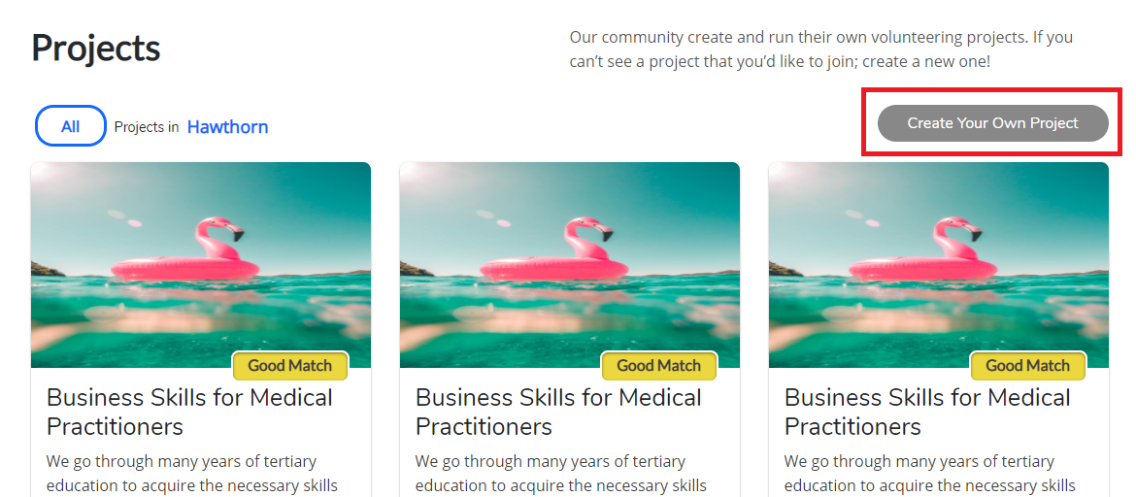
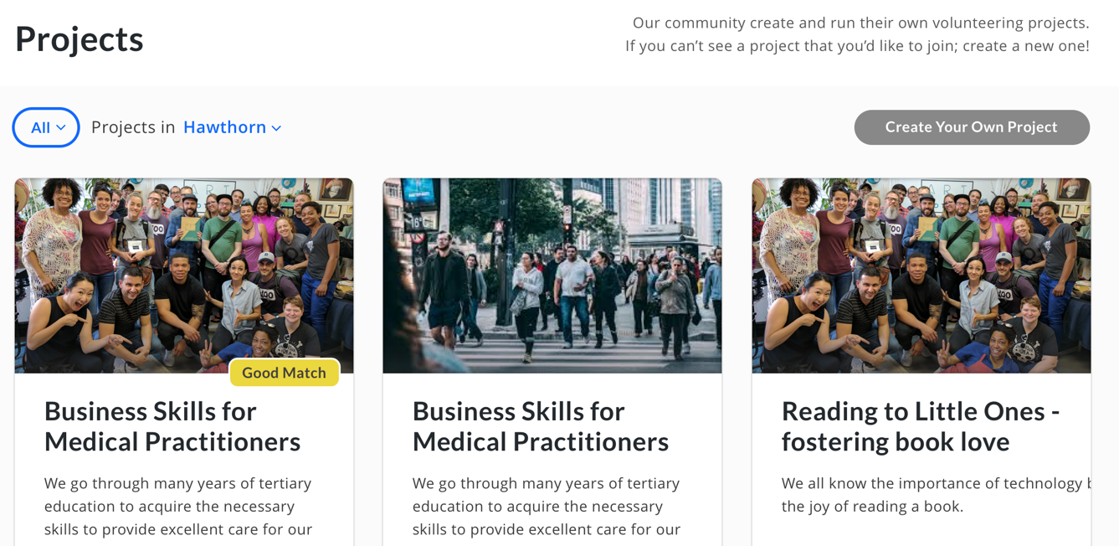
Q2: Project List (1)
2-1 Is it possible to click ‘create project’ on project list page? I mean creating project needs to be in a tribe detail.
Before knowing the tribe which can be one of project, we may not create a project.
Anyway if you want to create a project in project list page, you need to lead to a selecting tribe page or you need to add a tribe field on creating project page…

Slide 4
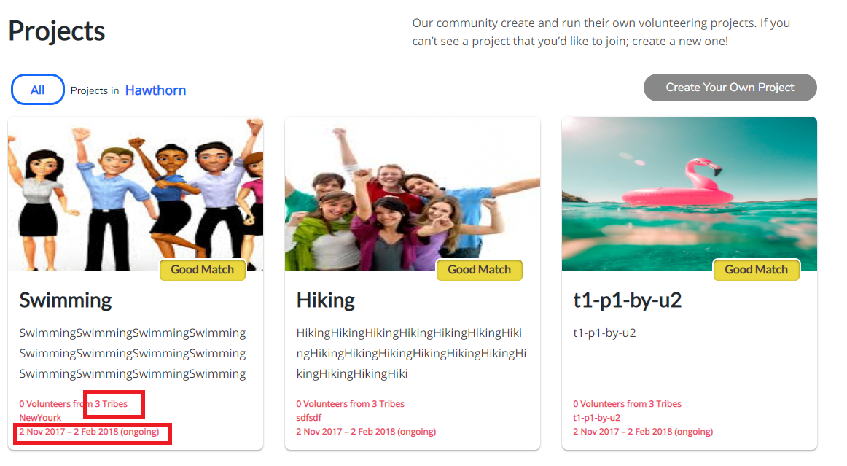
Q3: Project List (2)
3-1 I don’t understand the count of tribes at ‘X Volunteers from 3 Tribes’
Project may have several members.
Each member belongs to several tribes.
So how can I determine the count of tribes at a project?
3-2 does each project have start time and end time?
Does each project have status like ongoing and what else?
Can I see the start time, end time, ongoing in project create page?

Slide 5
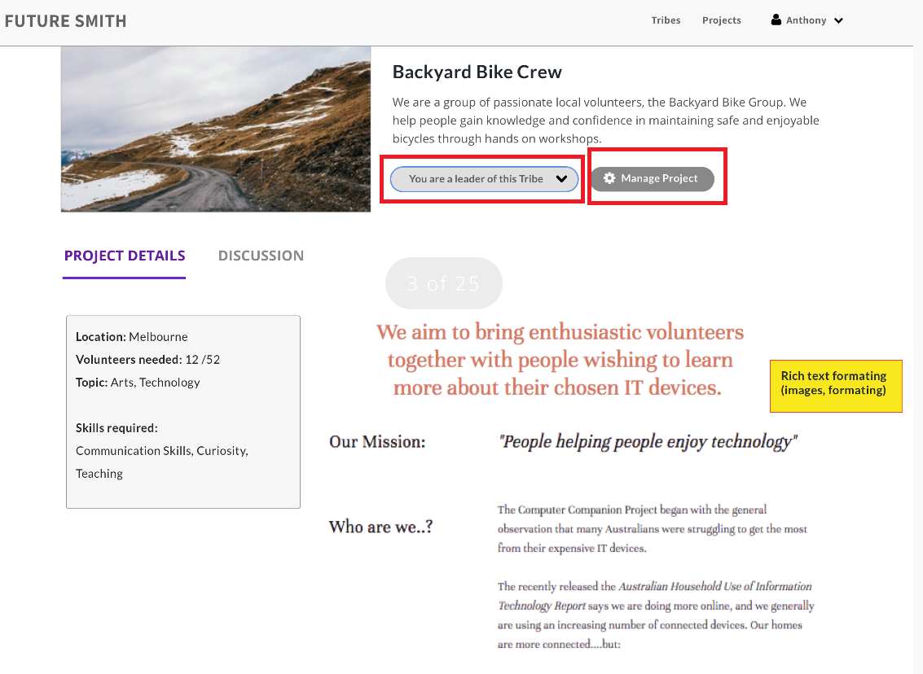
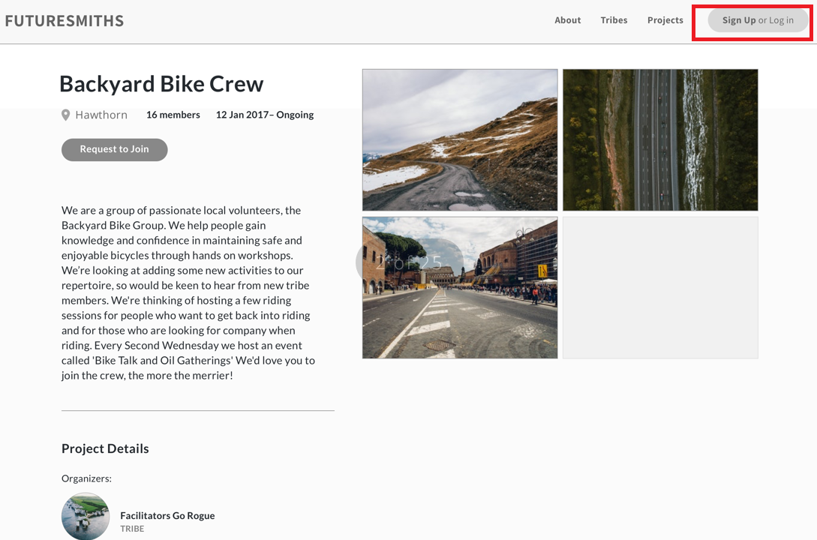
Q4: Project Detail (1)
4-1 These two designs are for ‘project details’. What are different from each other?
I think left one is for guest who doesn’t sign up and right one is for project member and project leader.
Right? – Correct
If so, in right screen, what’s the difference from project member and leader? Maybe leader can see ‘manage project’ button and ‘You are a leader of this Project’; and member only can see ‘You are a member of this project’. Right?

Slide 6
Thanks for reviewing my questions.
dejan

